Slide 1
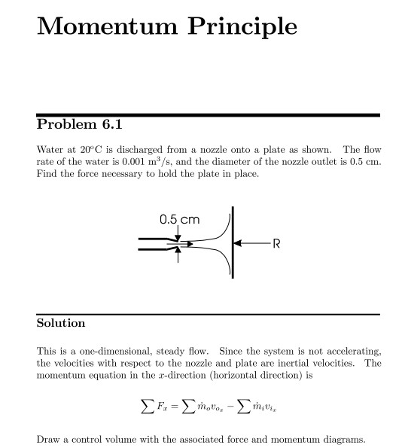
Fluid Mechanics Class Note
Dr. Qassem Hamed Jalut Associate Professor

Slide 2
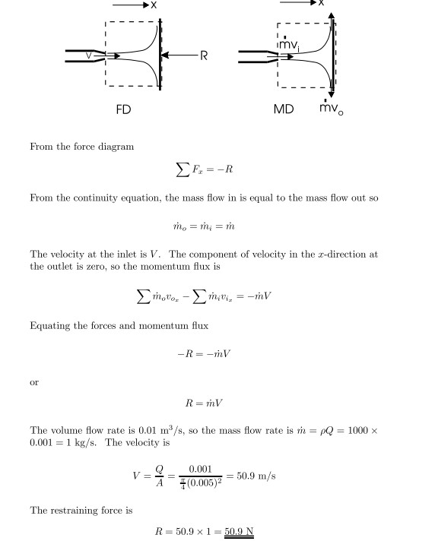
Fluid Mechanics Class Note
Dr. Qassem Hamed Jalut Associate Professor
Problem 2

Slide 3
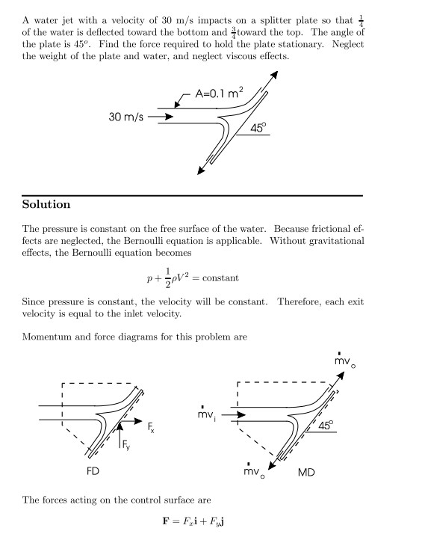
Fluid Mechanics Class Note
Dr. Qassem Hamed Jalut Associate Professor

Slide 4
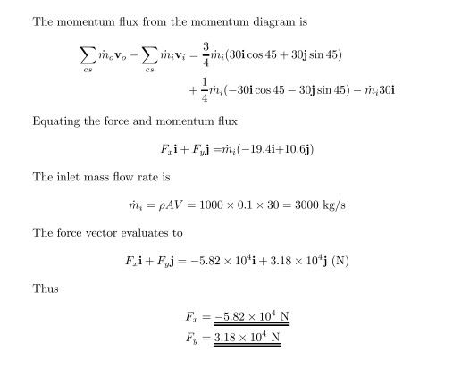
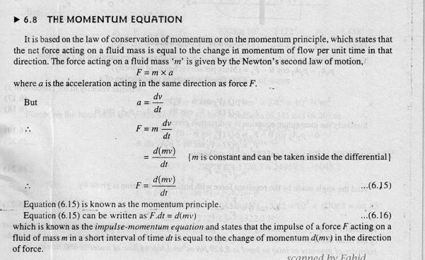
Fluid Mechanics Class Note
Dr. Qassem Hamed Jalut Associate Professor

Slide 5
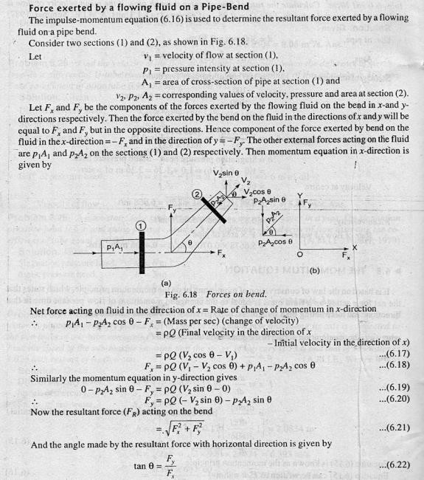
Fluid Mechanics Class Note
Dr. Qassem Hamed Jalut Associate Professor

Slide 6
Fluid Mechanics Class Note
Dr. Qassem Hamed Jalut Associate Professor
100

Slide 7
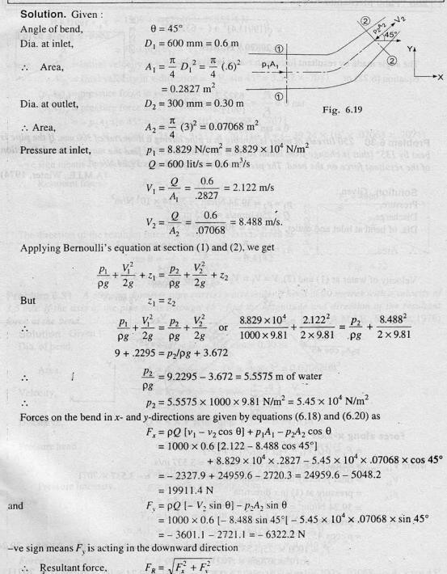
Fluid Mechanics Class Note
Dr. Qassem Hamed Jalut Associate Professor

Slide 8
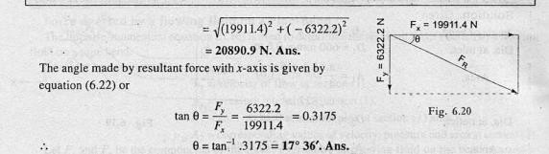
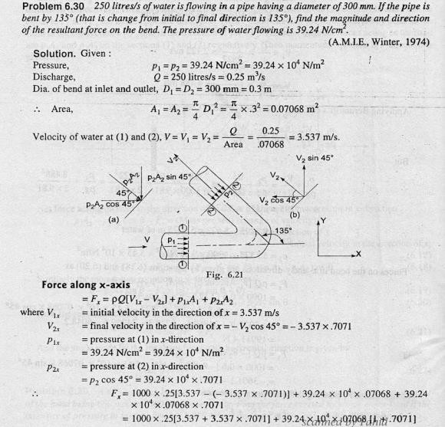
Fluid Mechanics Class Note
Dr. Qassem Hamed Jalut Associate Professor

Slide 9
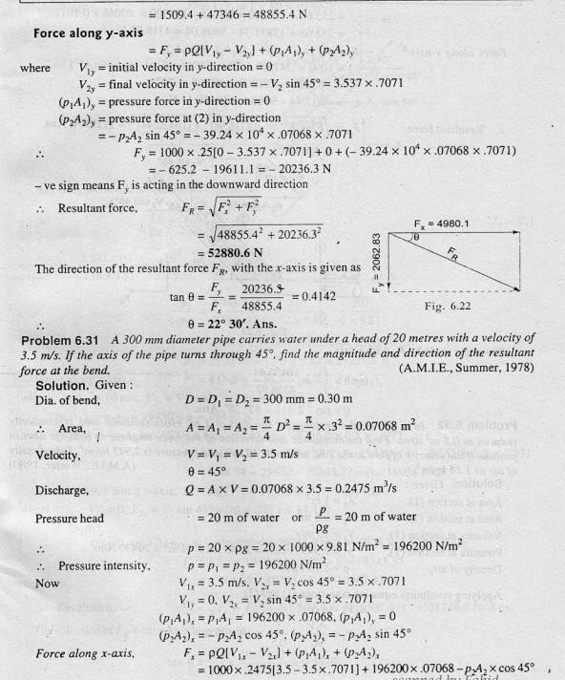
Fluid Mechanics Class Note
Dr. Qassem Hamed Jalut Associate Professor

Slide 10
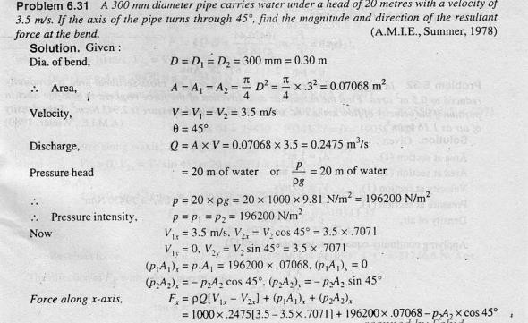
Fluid Mechanics Class Note
Dr. Qassem Hamed Jalut Associate Professor

Slide 11
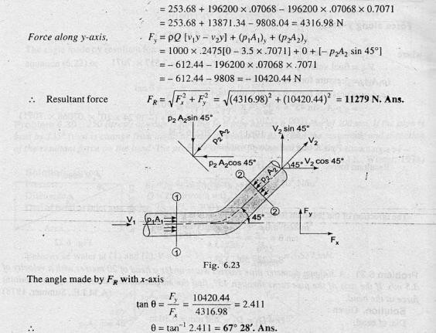
Fluid Mechanics Class Note
Dr. Qassem Hamed Jalut Associate Professor

Slide 12
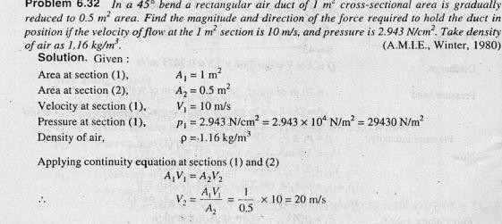
Fluid Mechanics Class Note
Dr. Qassem Hamed Jalut Associate Professor

Slide 13
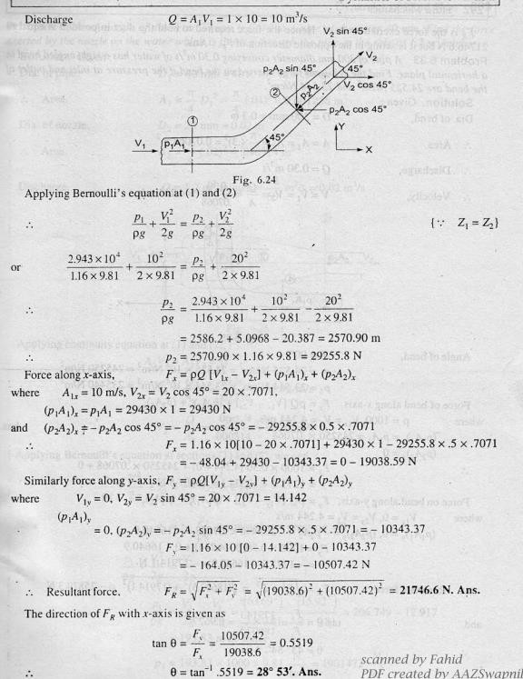
Fluid Mechanics Class Note
Dr. Qassem Hamed Jalut Associate Professor

Slide 14
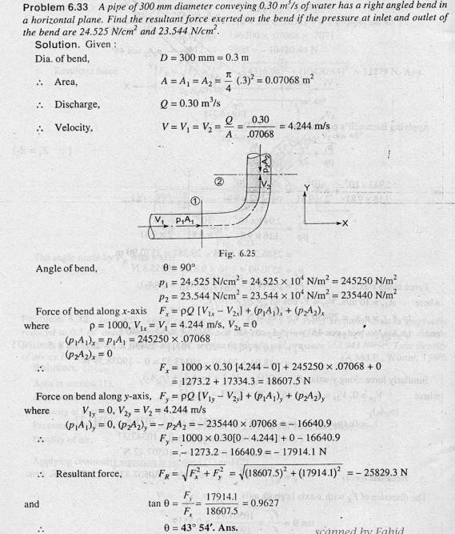
Fluid Mechanics Class Note
Dr. Qassem Hamed Jalut Associate Professor

Slide 15
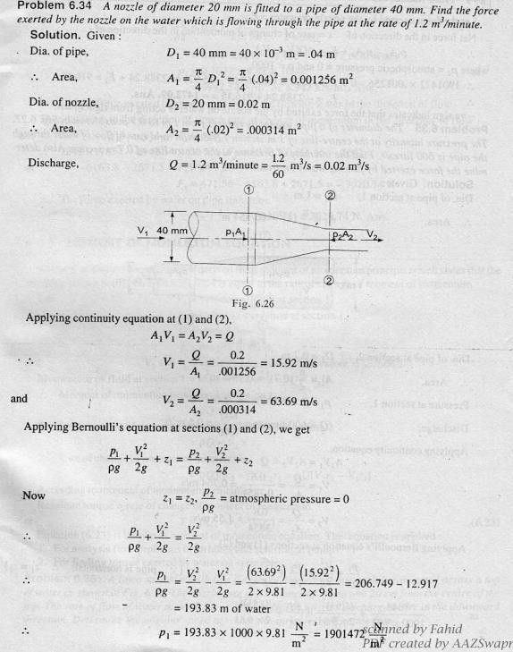
Fluid Mechanics Class Note
Dr. Qassem Hamed Jalut Associate Professor

Slide 16
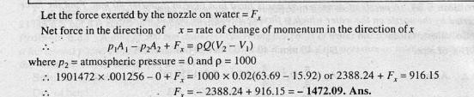
Fluid Mechanics Class Note
Dr. Qassem Hamed Jalut Associate Professor
110

Slide 17
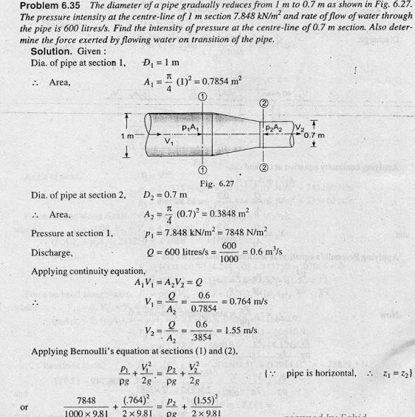
Fluid Mechanics Class Note
Dr. Qassem Hamed Jalut Associate Professor
111

